Slide 1


Cloud Computing with AWS Training

Slide 2















Cloud computing enables a user to focus on their projects and customers, without worrying about infrastructure concerns. It not only saves time, money, and effort but also allows users to concentrate on the differentiating aspects of their business.
Netflix, Expedia, Spotify, and Ubisoft are some of the top companies that utilize AWS. In fact, AWS holds about 41.5 percent of all installed application workloads. Its market share, in 2017, was about 47 percent with a whopping Q4 revenue of $3.66 billion.
Cloud Computing
Servers
Virtual Desktop
Software Platform
Applications
Storage/ Data
AWS offers every benefit that one expects from cloud. It is considerably superior to other cloud service providers in the market in many aspects such as data availability and high transfer stability.
This Cloud Computing with AWS course begins by discussing the basics of AWS and Cloud Computing, then moves on to discussing intermediary level concepts such as service Models (IaaS, PaaS, SaaS) and Amazon Virtual Private Cloud (VPC) and ends with diving deep into the particular elements of the AWS platform in detail.
Router
Switch
End User
As part of the course participants get a chance to explore VPC, Route53, IAM, EC2, S3, Cloud Front, Autoscaling, Load Balancing, RDS, RedShift, CloudWatch, CloudFormation, Elastic Beanstalk, CloudTrail, Trusted Advisor, SQS, SWF, Lambda, SNS, DynamoDB, Glacier, EFS, Elastic Transcoder, Kinesis, Direct Connect, Snowmobile and API Gateway.
The course encompasses hands-on exercises and real-time use cases to ensure that participants develop a thorough practical understanding of the concepts.

Slide 3


WHO SHOULD STUDY CLOUD COMPUTING WITH AWS?
ELIGIBILITY / PRE-REQUISITES

Slide 4






TRENDS IN THE AWS CLOUD COMPUTING + INDUSTRY VIEWS
“The demand for hybrid cloud has been gaining popularity, particularly among midsize enterprises, including manufacturing companies, regardless of their expensive nature.” Technavio
“The public cloud services market will grow rapidly to
$236 Billion in 2020” Forrester
“Cloud-based security services will be worth $9 billion in 2020” Gartner
“Cloud computing is projected to increase from $67B in 2015 to $162B in 2020 attaining a compound annual growth rate (CAGR) of 19%” Forbes
“By 2020, a corporate ‘no-cloud’ policy will be as rare as a ‘no-internet’ policy is today” Gartner

Slide 5

















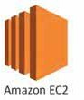



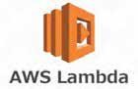
PROGRAM STRUCTURE
Internet
48 hours live online training with an Industry Expert Instructor
POC support and multiple assignments to gain thorough understanding
Training within Amazon Webserver Ecosystem
AMAZON WEB SERVERS

Slide 6
DETAILED CURRICULUM : CASE STUDIES
Case Study #1: “ ”
An organization decides to migrate from on-premise solutions to AWS. This would reduce its turnaround time to deliver products to its customers
customer implementations in a span of weeks instead of months. Also, they are now able to encourage and focus on being innovative and relevant.
Case Study #2: “Digital arketing ”
A large enterprise needed a cloud hosting provider with global infrastructure to support their countless web properties scattered all over the world. The enterprise felt that by making this move, they would not only enhance business agility and operational efficiency but also gain a competitive advantage in the market.
By making the move, they were able to launch digital marketing campaign and set up the entire website infrastructure for the same in a span of
Case Study #3: “Big Data Analysis”
An organization provides programmatic advertising solutions to customers across the globe. It processes Big Data (no hyphen in between) queries from thousands of sources in just a few seconds. It scales up using AWS to keep up with growing demand.
They need about three months to procure the hardware, and set up everything in the data center. They use AWS to build a sophisticated Big Data platform on the cloud, effectively eliminating the need for back-end management. Post scaling up, they support over 400 instances, with fewer employees.

Slide 7
DETAILED CURRICULUM : MODULES
Introduction to Cloud Computing
Introduction to Cloud Computing
Why Cloud Computing?
Benefits of Cloud Computing
Public Cloud, Private Cloud, Hybrid Cloud
Service Models (IAAS, PAAS, SAAS)
Amazon Web Services (AWS) Introduction to AWS
Elastic computing.
Introduction to the AWS products.
Regions and Availability Zones.
Signing up for AWS.
AWS Free usage tier.
Introduction AWS management console.
Take a digital tour of an AWS Data Center.
EC2 Compute Service
EC2 Introduction
Spinning Windows/Linux servers in EC2
Connecting to Instances using RDP, MobaXTerm, Putty
EC2 Vertical Scaling Overview and Scale UP and Scale Down Servers
Security Group Basics and Implementing Security for Real Time Environments.
Understanding Block Level Storage using EBS.
Con guring SSD/HDD/Magnetic Storage for Windows and Linux Servers
Implementing Scaling for EBS Storage.
Con guring VOLUME-SNAPSHOT-VOLUME Process

Slide 8
DETAILED CURRICULUM : MODULES
Automating Backups for Instances using Snapshots
Understanding AMI and Its Features
Creating AMI for Windows/Linux Servers.
Con guring INSTANCE-AMI-INSTANCE Lifecycle
Real time use case for Boot Strapping for EC2 Instances
Amazon Virtual Private Cloud (VPC)
Introduction to VPC
IPv4 Addressing Scheme
Public and Private IP’s
Understanding Subnetting
Elastic IP’s
Basic VPC con guration
Implementing Private/Public subnets in VPC
VPC security
Inbound and outbound ACL’s
Deep Dive in to VPC core concepts (Route Tables, Subnets, Internet Gateway)
Building Custom VPC Network Topology for Real Time Environments
Implementing NAT (Network Address Translation) in VPC
ELB (Elastic Load Balancer)
Introduction to ELB.
Implementing HA using Load Balancer for Websites.
Understanding ELB Load Distribution using Round Robin Algorithm.
Understanding Health Checks.
Con guring Advanced VPC and Cross Zone Load Balancing
Adding and removing instances on ELB

Slide 9
DETAILED CURRICULUM : MODULES
Simple Noti cation Service (SNS)
Introduction to SNS.
Creating topics and Evaluating ARNs.
Subscribing using Various Protocols.
Publishing Noti cations using SNS.
Integrating SNS Topics with CloudWatch and Autoscaling Services.
CloudWatch
Introduction of AWS Monitoring
Understanding Virtualization
Making a Status Check Failed Incident manually
CloudWatch Basic and Detailed Monitoring and Its Features.
Implementing Real Time monitoring by Integrating with SNS.
Understanding CloudWatch Logs and Metrics.
Creating Alarms and Its Actions.
Con guring Dashboards for Organization Architectures.
Relational Database Service (RDS)
Introduction to Relational Databases.
Creating Relational Databases in RDS.
Connecting to RDS Database Instances using SQLYog.
Installing a WordPress APP using RDS Database.
Automating Backups and Patching for Various Database Engines.
Creating Redundant and Fault Tolerant Databases.
Implementing Read Replicas for Read Heave databases.
RDS Resilient Architecture using Point in Time Recovery.
Con guring Event Noti cations for Database Instances.
Understanding Parameter, Option, and Subnet Groups.

Slide 10
DETAILED CURRICULUM : MODULES
Auto scaling
Understanding Horizontal vs. Vertical scaling.
Understanding Auto Scaling.
Create a launch con guration.
Create an Auto Scaling group.
Understanding Various Scaling Types (Dynamic, Scheduled, Step, Target Tracking Scaling Policies).
Setting up an auto-scaled, load-balanced Application using Autoscaling.
Route53
Introduction of Domain Name System.
Buying Domain names at Domain Registrars.
Creating Zones on Route53.
Creating Route53 Records (Address, CNAME, Alias).
Creating Health Checks in Route53.
Understanding routing policies provided by AWS.
Simple Routing Policy and its Implementation.
Weighted Routing Policy and its Implementation.
Latency Routing Policy and its Implementation.
Failover Routing Policy and its Implementation.
Geolocation Routing Policy and its Implementation.
Routing Policies Use cases and When to use Which Policy.
S3 (Simple Storage Service)
Introduction to AWS Object Storage.
Creating S3 Buckets and Uploading Data in to it.
S3 durability and redundancy.
Various S3 Storage Types (Standard, Infrequent, One Zone)
Con guring S3 Versioning, Logging, Encryption.

Slide 11
DETAILED CURRICULUM : MODULES
Hosting a Static Website on S3.
Implementing Lifecycle and replication for S3 Buckets.
Understanding S3 Analytics, Metrics and Inventory.
CloudFront
Introduction to Content Delivery Network (CDNs).
Understanding AWS EDGE Network Locations.
Understanding CloudFront Distributions and Origins.
Implementing CDN for Websites using CloudFront.
Going through CloudFront Reports and Analytics.
CloudFront Security for S3 buckets using OAI (Origin Access Identity).
Con guring origins and behaviors.
Identity access management (IAM)
Introduction of IAM Service.
Creating Users and Groups.
Grant Least Privilege.
Con guring a Strong Password Policy for your Users.
Enabling MFA for Privileged Users.
Granting permissions using IAM Policies.
Creating Custom Policies and Associating to Users and Groups.
Understanding Roles.
IAM Access Credentials and its usages.
AWS CLI.
Elastic Beanstalk
Understanding DevOps tools of AWS.
Automation by Elastic Beanstalk.

Slide 12
DETAILED CURRICULUM : MODULES
Creating an Application Environment using EB.
Application versioning and Deploying.
Clean up of EB Environment.
Cloud Formation
Introduction to Cloud Formation
Understanding Stacks and Cloud Former Tool.
Automating a Ruby on Rails Application using Cloud Formation.
Clean up of Cloud formation Environment.
Creating custom Templates using Cloud Former Tool.
Dynamo DB
Understanding NOSQL Databases.
Creating a DynamoDB table with Sample Data.
Understanding RCU and WCU of DynamoDB Tables.
Understanding Throttling in DynamoDB.
Creating Alarms in DynamoDB.
Glacier
Introduction to Glacier Storage.
Creating Vaults.
Uploading data to Vaults.
Key di erences between S3 and Glacier.
CloudTrail
Introduction to Audit logging by CloudTrail.
Creating Trials.
Storing Trial logs in S3 Buckets.

Slide 13
DETAILED CURRICULUM : MODULES
Trusted Advisor
Introduction to Trusted Advisor.
Understanding Cost Optimization Tab.
Understanding Performance Tab.
Understanding Security Tab.
Understanding Fault Tolerance Tab.
Understanding Service Limits Tab.
Elastic File System
Introduction to EFS.
Creating EFS and mounting on Linux Servers.
AWS Application Services for Certi cations
SQS Overview and implementing polling messages.
SWF Overview.
Introduction to Elastic Transcoder.
Introduction API Gateway.
Introduction to Kinesis and Various types of Kinesis Streams.
Introduction of Lambda.
Implementing a sample script and executing by Lambda.
AWS Direct Connect.
AWS Snowmobile.
Redshift Overview.
AWS Cost Controlling Strategies
Introduction to AWS Pricing.
Understanding AWS Pricing Models (On Demand, Reserved, Spot).
Best Practices for Cost Optimization.

Slide 14
DETAILED CURRICULUM : MODULES
AWS Well Architect Framework
Introduction to Well Architected Framework.
Security Pillar.
Reliability Pillar.
Performance E ciency Pillar.
Cost Optimization Pillar.
Operational Excellence Pillar.
AWS Certi cations
List of AWS Certi cations.
Enrolling for AWS Certi cation.
AWS Practice Exam.
Tips and Tricks for Cracking the Exams.
Going through the sample questions and implementing tricks on live session.

Slide 15
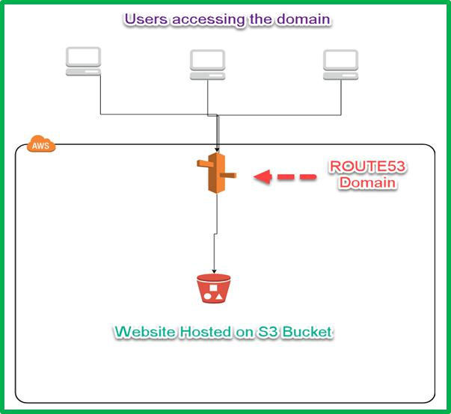
PROJECT 1: HOSTING A STATIC HTML WEBSITE ON S3
We are hosting a html website on S3 bucket using static website hosting option on S3 and point the S3 bucket endpoint to a domain name using Route53.

Slide 16
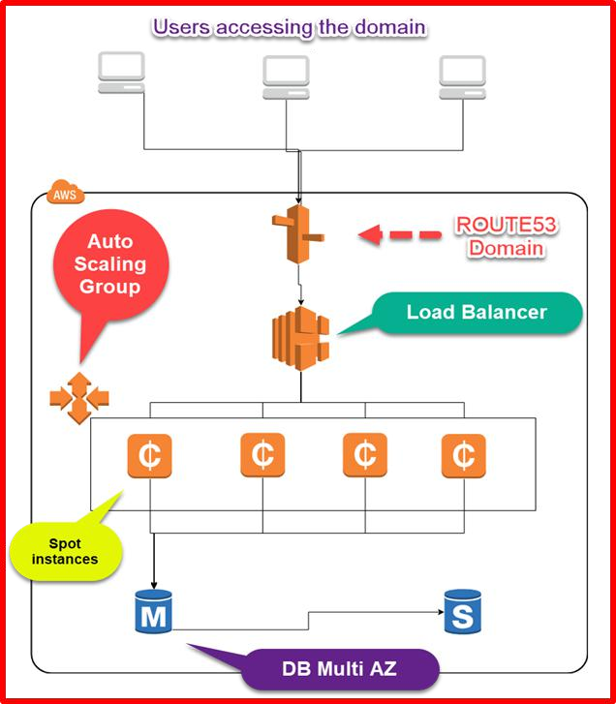
PROJECT 2: HOSTING A JAVA WEBSITE 3 TIER WEBSITE USING SPOT INSTANCES
We are hosting a java website on ELB, EC2 Spot Instances, and RDS.
We will use ELB as Web TIER and Spot Instances as APP Tier which hosts the application which we will deploy on Tomcat. And we will integrate JAVA app with RDS for DB TIER with Multi AZ enabled.

Slide 17
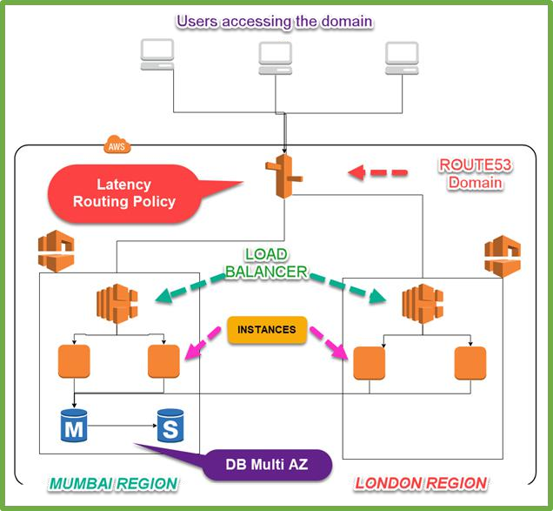
PROJECT 3: HOSTING A WORDPRESS WEBSITE AS REDUNDANT AND FAULT TOLERANT USING MULTI REGION ARCHITECTURE
We are hosting a WordPress website on AWS using ELB, Route53 Latency Routing Policy, EC2, and RDS Multi AZ.
We will host the website on two regions, so that if one region is fully down still our customers can be able to access the website without any down- time.

Slide 18









KEY DIFFERENTIATORS
LIFETIME LMS ACCESS
24 x 7 SUPPORT
REAL-LIFE PROJECTS & CASE STUDIES
INDUSTRY EXPERTS AS TRAINERS
INDUSTRY STANDARD CERTIFICATE

Slide 19




AWS CLOUD SOLUTION ARCHITECT
AWS CLOUD OPERATION ENGINEER
AWS CLOUD ADMINISTRATOR

